Slide 1
TDI: Julia
Tuples, Arrays and Dictionaries
William Mui

Slide 2
Why we need Tuples, Arrays and Dictionaries

Slide 3
Why we need Tuples, Arrays and Dictionaries
Organize the related data (e.g. weather of each day)
Readability
Easier for iteration

Slide 4
Tuples

Slide 5
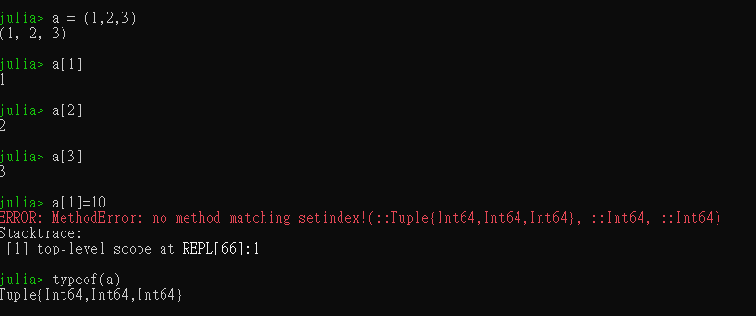
Tuples
Collection of values
Values(elements) in tuples can be of any type
Indexed by integers
Immutable

Slide 6
Example - Definition
Define the new tuple by a pair of parenthese.
All elements splitted by comma

Slide 7
Example - Access
Similar to string, using
name of variable
square brackets
position

Slide 8
Array

Slide 9
Array
Mutable version of Tuple
append/remove values is allowed
Defined by pair of square bracket

Slide 10
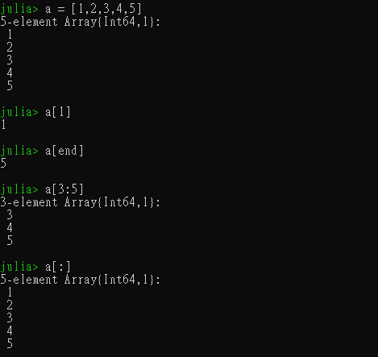
Example
Similar to string and tuple

Slide 11
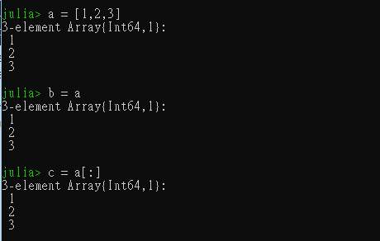
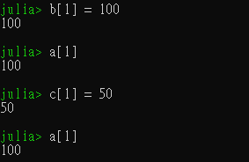
Copy the array?
Create a variable, which is pointing to the exist array

Slide 12
The correct method
We should use the : operator to copy the array
Point to different array

Slide 13

Dot Syntax
Shortcut for mathematical calculation on array
For example:
we have the expression: [1, 2, 3] .^ 3, it is equivalent to [1^3, 2^3, 3^3]
Dot Syntax could be applied on function.

Slide 14
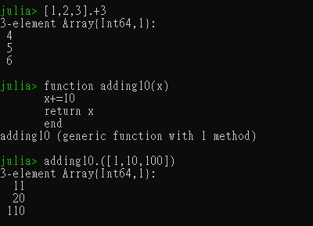
Examples
The first one is apply dot syntax on operators
The second is apply dot syntax on function

Slide 15
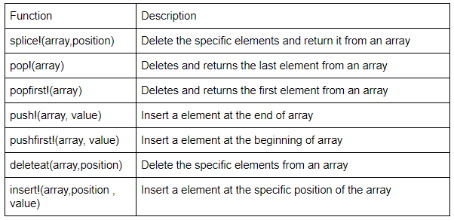
Deleting and Inserting Elements
Array is mutable
Using built-in function

Slide 16
Dictionaries

Slide 17
Dictionaries
Similar to array
storing several values
Mutable
Array using continuous integer(index) to store and access data
Dictionaries using either
number(both integer and floating point)
character
String
As the key to access data

Slide 18
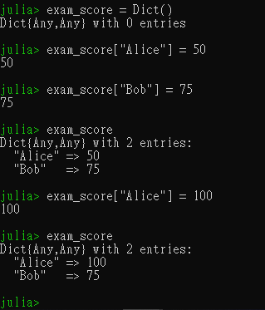
Dictionaries
key-value mapping
Initialized by the built-in function Dict()

Slide 19
Example
The method of accessing the data and assigning the data is very similar
by exam_score[ (name of student)] = value

